Slide 1
Neural Network Simulation
-Simulation Overview
-Activation Function
-Single Neuron Structure
Jack Wu

Slide 2
Step One.
Connect a brain to your computer.
We start by opening up one unfortunate human’s head and take out his or her brain, then Google ‘How to connect a brain to a laptop via USB’.

Slide 3
You Can’t.
You simply can’t. Our computer only recognize 0 and 1.

Slide 4
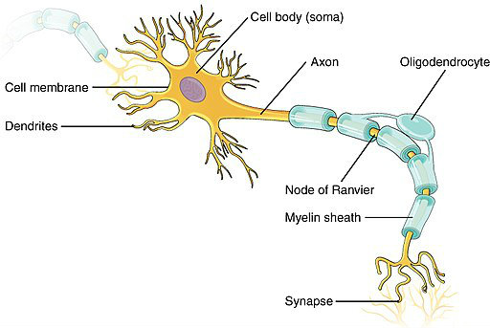
So we simulate a brain.
Axon
Sends out a signal.
Dendrites
Receives signal.
Synapse
Connects and transfers signal from one axon to some dendrites on another nerve.

Slide 5
Activation
More in detail about how Synapse works.
As we said before, the Synapse sends out signal. It experiences an ‘activation’ process. When the voltage on the axon reaches a certain value, it sends out an electric pulse to the next dendrite.

Slide 6
Process Map
Input data.
Activate and output some data.
Receive data.

Slide 7
Simulation Process
1
x1
Activation Function
y
x2
x3
Input data.
Activate and transfer data.
Receive some data.

Slide 8
Simulation Process
1
w0
x1
w1
Ʃ
y
x2
w2
w3
x3
y = activation function(w0 + w1x1 + w2x2 + w3x3)
Input data.
Activate and transfer data.
Receive some data.

Slide 9
Explanation
y = activation function(w0 + w1x1 + w2x2 + w3x3)
x(x1, x2, x3, …): Input data, simulates Axon in a real neuron.
y: Output, simulates Dendrites, and there is only one output.
w(w0, w1, w2, w3): Weight, simulates the Synapse, and connects input to output.
Activation function: Simulates how neurons activates each other. When the sum(w0 + w1x1 + w2x2 + w3x3) is larger than the critical value, the neuron passes output down to the next neuron.

Slide 10
One Neuron
Input x[1], …, x[n], and intercept x[0] = 1
Sum pass through an activate function.
Output y

Slide 11
END

